Slide 1
Tableau Tips
Luoyu Shen

Slide 2
Introduction
Interactivity is a crucial part of data analysis that allows the user to stay engaged at all times, generate queries, and solve them without breaking the flow of the analysis.
Today, we are going to explore various ways to integrate interactivity in Tableau.

Slide 3
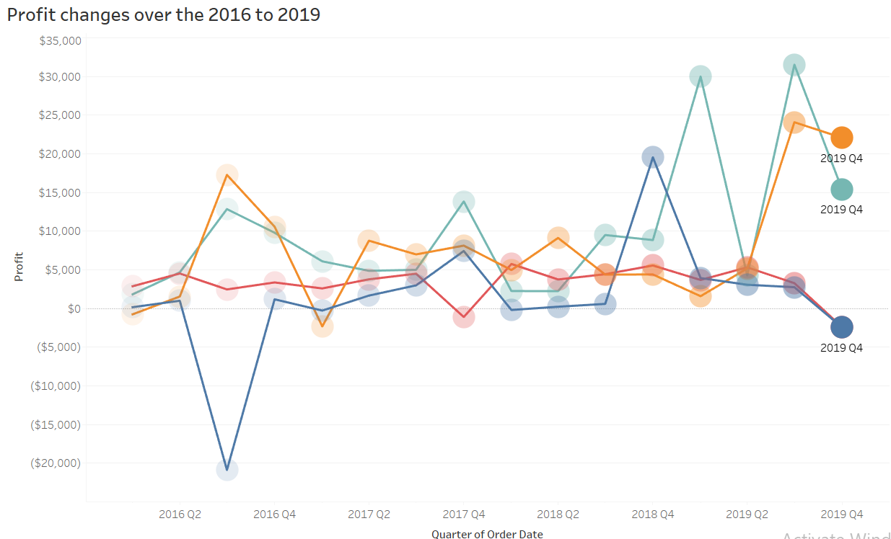
Creating a motion chart
Is a chart that displays the entire trail of changes in data over time by showing movement using the X and Y-axes.
Tableau’s page control allows us to flip pages.
Question:
How profit changes over time for each category.

Slide 4
Parameter
Parameters allow you to come up with scenarios or options that are not available in your data and create these values to put into your visualization.
Four Key Things That Must Be In Place For Parameters:
1. Create the Parameter
2. Use the Parmeter in a Calculation
3. Show the Parameter Control for the User
4. Use the Calculated Field in Your Visualization

Slide 5
Parameter - Creating a dynamic column/row trellis chart
Aka a panel chart or grid chart, is a small multiple chart composed of multiple similar, small charts that allow for easier adjacent comparison of the items being visualized.
Using INDEX() function assigns a sequential number
To display small charts with the use of a specific number of columns and rows, we can introduce a discrete dimension in Columns and then, calculate how many rows will result based on the number of columns.
Dimension | INDEX() | INDEX()% 3 | Column | Row
A | 1 | 1 | 1 | 1
B | 2 | 2 | 2 | 1
C | 3 | 0 | 3 | 1
D | 4 | 1 | 1 | 2
E | 5 | 2 | 2 | 2
F | 6 | 0 | 3 | 2

Slide 6
Parameter - Creating a top/bottom N filter
By creating a top/bottom N filter, we allow the end users to select whether they want to display the top N countries or bottom N countries.

Slide 7
Parameter - Dynamically displaying dimensions and measures
Normally, when we create our charts, we choose the dimensions and measures to display and place them on the appropriate shelves.
But if we want to show different dimensions and measures in one view, what can we do?
We can introduce parameters so that users can dynamically decide which dimension or measure they want to use.

Slide 8
LOD
Level of Detail (LOD) has three important calculation levels. These are:
Non-viz level of detail
Window_sum(SUM([Profit])): Aggregated aggregation
{FIXED <DIMENSION>: SUM([Profit])}: Aggreagation
Granularity
viz level of detail
SUM([Profit])/SUM([Sales])
Aggregation
Row level of detail
[Profit]/[Sales]

Slide 9
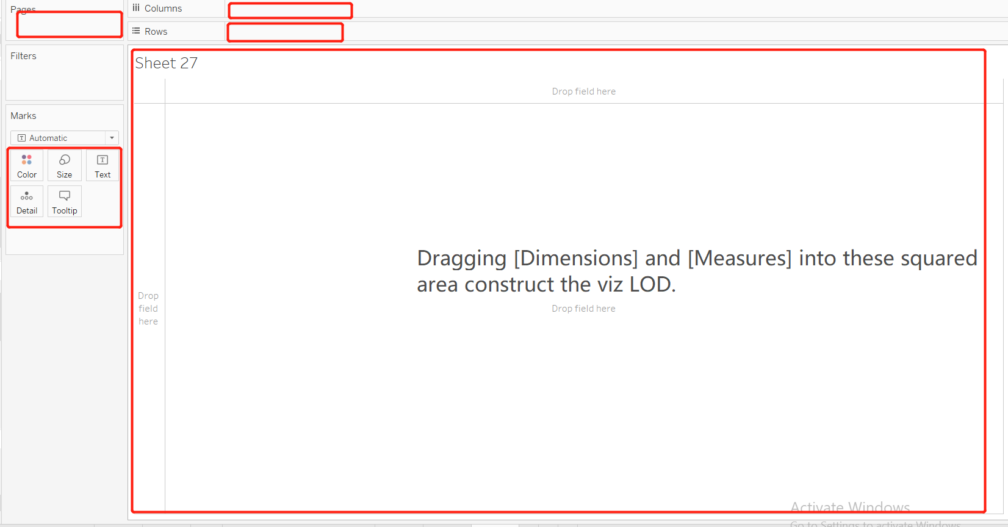
View lod

Slide 10
LOD expressions
Is a syntax expression for LOD to add new LOD based on the original LOD.
{FIXED | INCLUDE | EXCLUDE <dimension declaration>: <aggregate expression>}
Limitation： dimension declaration must be a persistent field.
QUESTIONS:
The average profit for each region
The average order profit by each region
Product : Order | N:1
Order : Region | N:1

Slide 11
Gantt charts
Can be incredibly useful for understanding any series of events with duration, especially if those events have some kind of relationship.
Visually they are very useful for determining if certain events overlap , have dependency, or take a longer or shorter time than other events.

Slide 12
Thanks

Slide 13
Questions?

Slide 14
Reference
https://interworks.com/blog/interworks/2012/03/26/how-to-create-and-use-parameters-in-tableau
Tableau 10 BOOTCAMP: INTENSIVE TRAINING FOR DATA VISUALIZATIONA AND DASHBOARD

